Slide 1

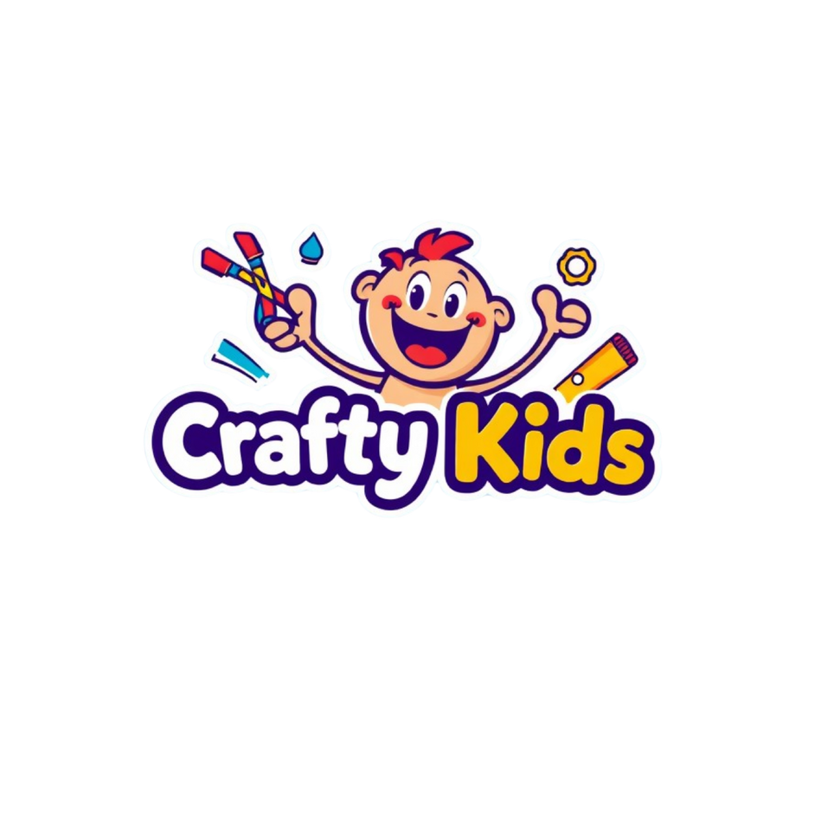
INSPIRING CREATIVITY IN CHILDREN
PRESENTATION MAY 2025
Crafy Kids

Slide 2

OVERVIEW
About us
BCM
SWOT
Objectives
Buyer persona
USP
Marketing Mix
Content calendar
Action plan
Ad content published
Controls KPI
Recommendations

Slide 3

ABOUT US
Crafty Kids is a fun and educational project. It helps children learn how to make things with their hands. At the same time, it helps them become more creative and solve problems better. The brand uses new science ideas and modern tools to make learning fun and easy for children

Slide 4


BUSINESS CANVAS MODEL

Slide 5
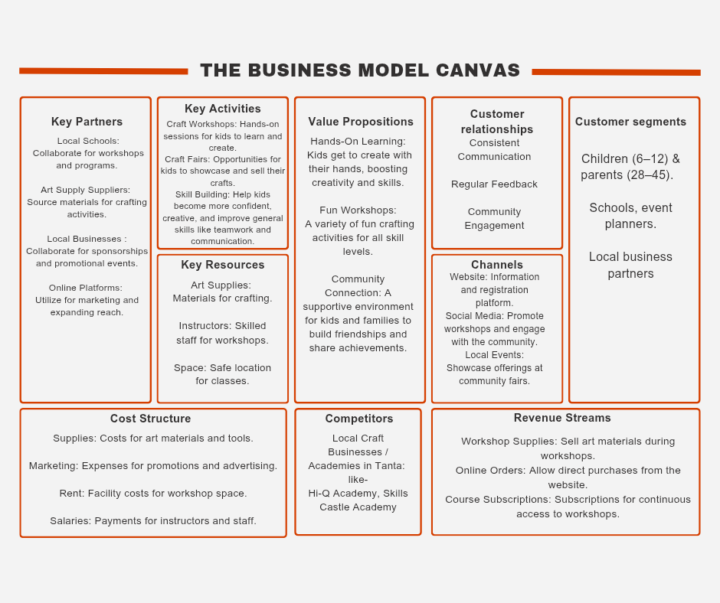
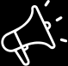
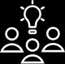
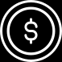
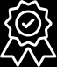
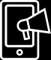
Write another activity, deadline or milestone here.

Slide 6
SWOT ANALYSIS

Slide 7

Strengths
Weaknesses
The team is passionate and knows the field well.
We have a professional team with strong organization skills.
Our curriculum is creative and different from others.
We get good support from the community around us.
We offer flexible classes, both online and offline.
The management team doesn’t have a lot of experience.
We don’t have enough tools or space to grow bigger.
Our budget for marketing is limited.
Opportunities
Threats
More Egyptian families are looking for creative activities for their kids.
We can partner with schools and community centers.
The government supports digital education and arts.
We can offer beginner workshops to attract new students.
Social media is a low-cost and powerful way to promote our work.
Economic problems in Egypt may affect families’ spending on extra classes.
More local competitors are offering similar craft programs.
Prices of materials are increasing due to inflation.
Changes in education policies may affect after-school activities.

Slide 8
SMART BUSINESS OBJECTIVES

Slide 9
SMART BUSINESS OBJECTIVES
01
Increase student enrollment by 50 students by December 2025 through marketing, better online classes, and school partnerships
01
02
03
04
02
Reach a student satisfaction score of 90/100 for classes by improving content and training teachers.
03
Raise social media engagement to 300 interactions per post by September 2025 through regular and creative content.
04
Conduct 6 beginner workshops and convert at least 12 attendees into full-course students by August 2025.

Slide 10
BUYER PERSONA

Slide 11

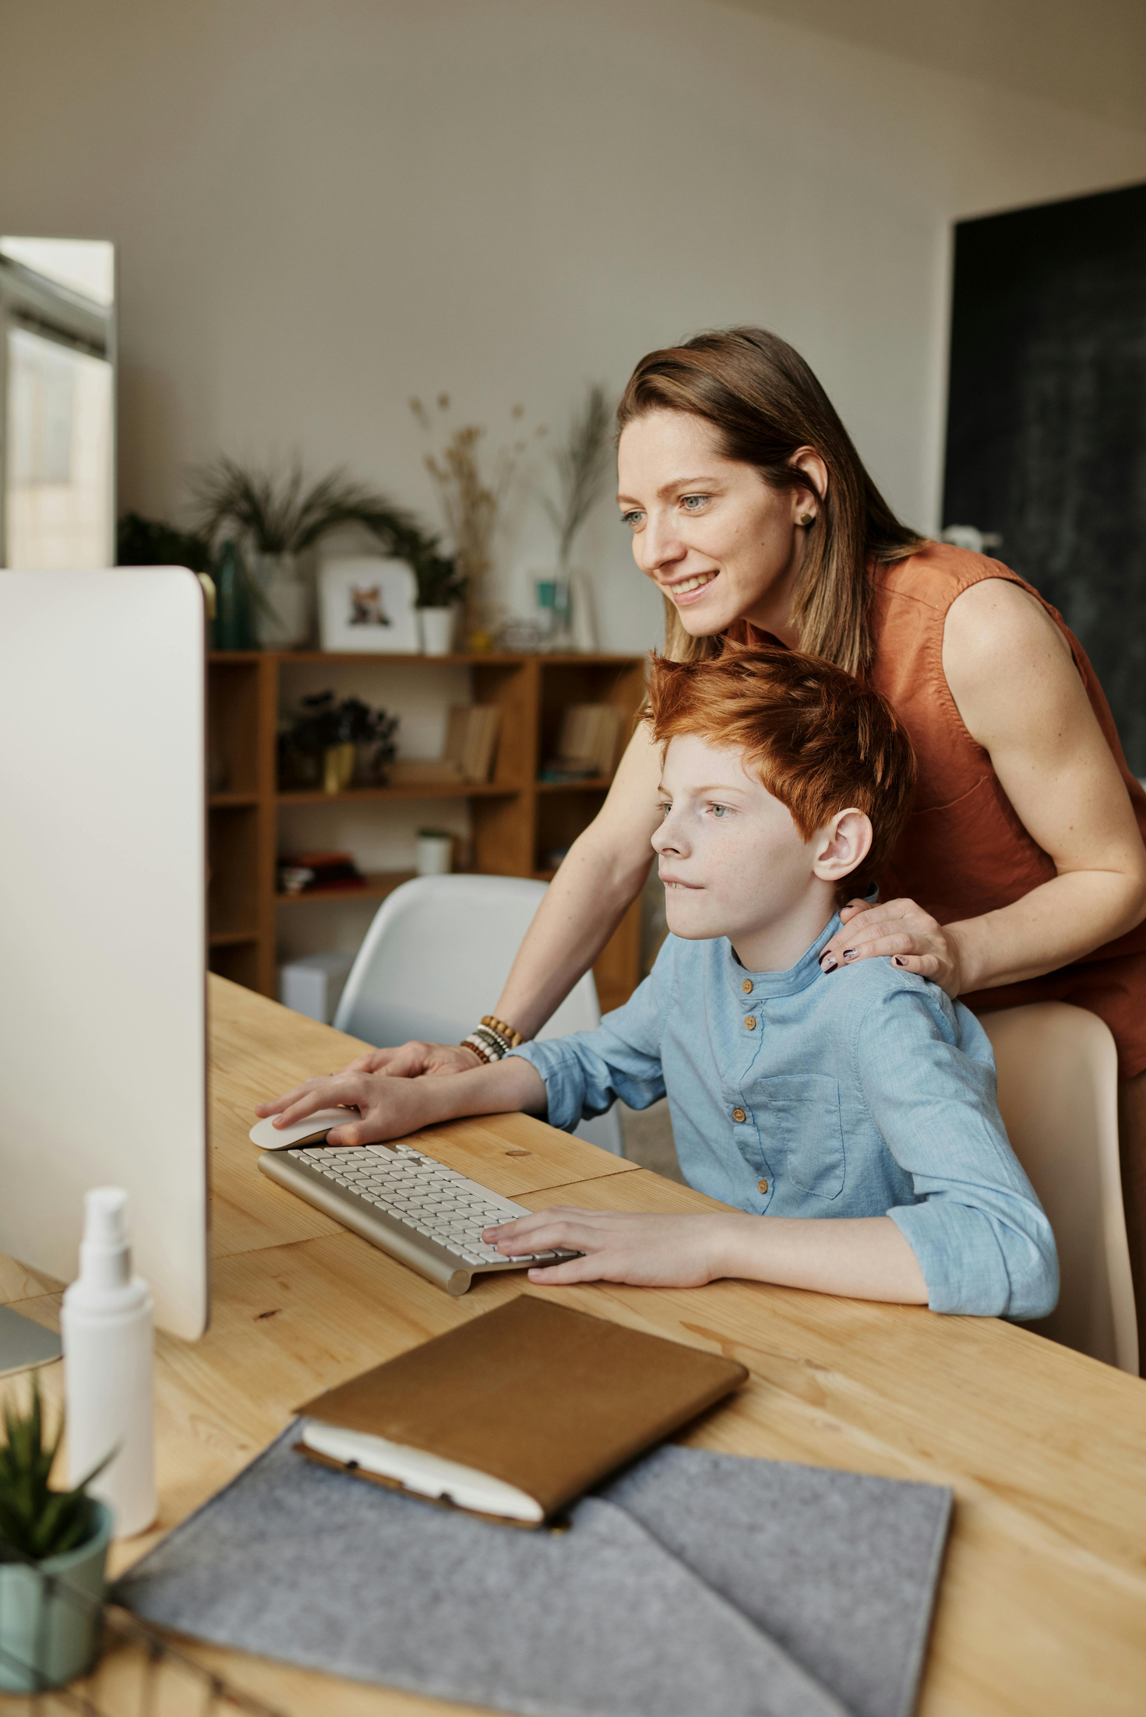
Amina
Goals& challenges:
Demographic Information:
Goals:
To find a fun and safe place for her kids to learn and be creative.
Challenges:
Keeping her kids engaged in educational activities.
Age: 30-40 years
Location: Tanta, Gharbia Governorate
Education: Bachelor's degree
Marital Status: Married with 2-3 children
Occupation: Teacher
Income Level: Middle-class
Information Sources:
Platforms: Facebook, Instagram.
Method: Relies on recommendations and reviews.
Behaviors & Interests:
Interests: Education, family time, child development.
Buying Behavior: Prefers activities that educate and entertain.
Gain from Crafty Kids:
Benefits: Provides a creative, safe space for learning and fun

Slide 12
UNIQUE SELLING PROPOSITION
(USP)

Slide 13

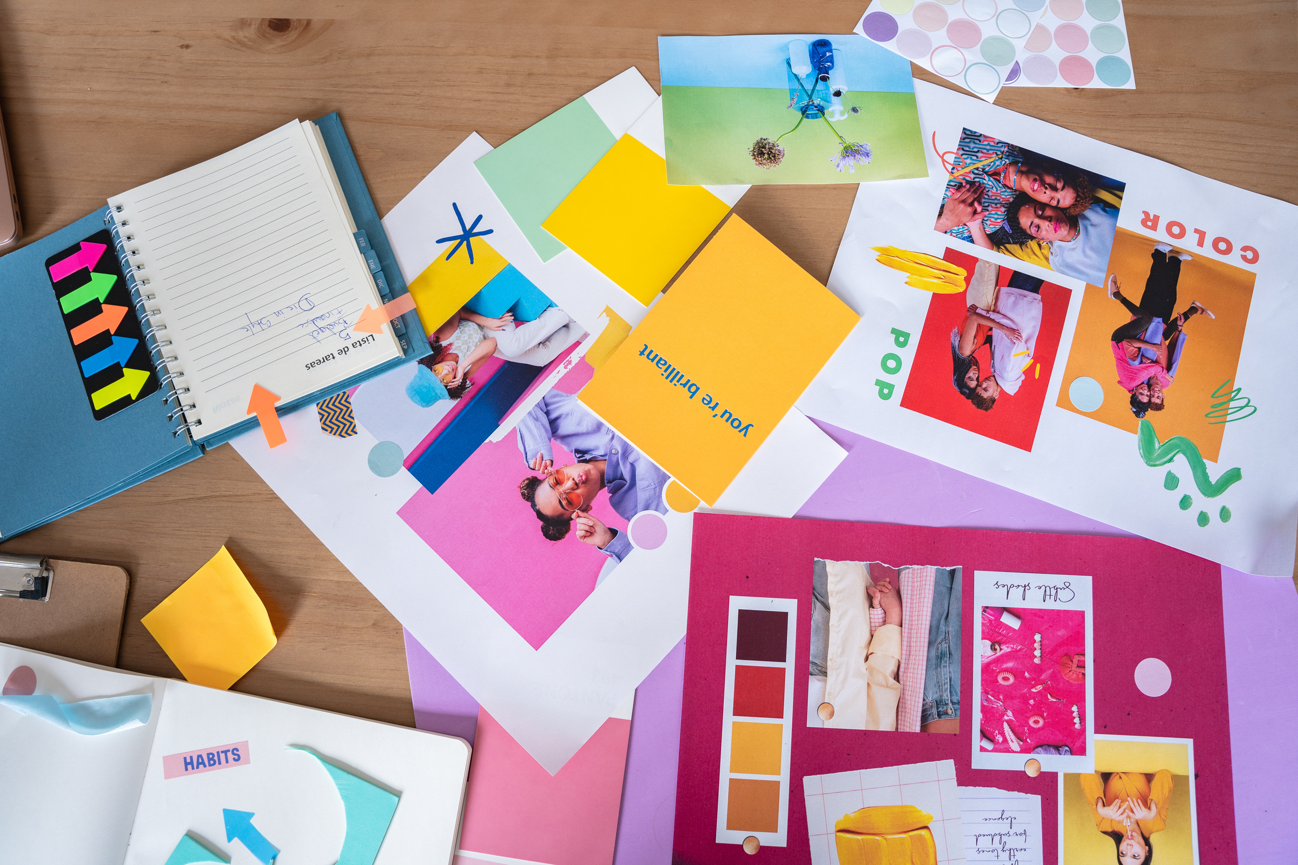
Crafty Kids inspires creativity in children through hands-on craft workshops and educational lessons, offering a unique learning environment that combines fun and skill-building.
Strategy 02
Strategy 03
Conduct market research.

Slide 14
MARKETING MIX (4PS)

Slide 15




Affordable prices for middle-class families in Tanta
Discounts for siblings and package subscriptions
Crafty Kids offers creative and fun learning for children.
Main services:
Craft workshops (painting, clay, paper crafts)
Skill-building classes (teamwork, problem-solving)
Online classes and DIY craft kits
Main location: Tanta city
Classes in a child-friendly center
Online options for remote learning
Partnerships with schools, libraries, and kids' clubs
Promotion channels:
Social media (Facebook, Instagram, YouTube).
Email newsletters for parents.
Collaboration with schools and community groups.

Slide 16
CONTENT CALENDAR

Slide 17
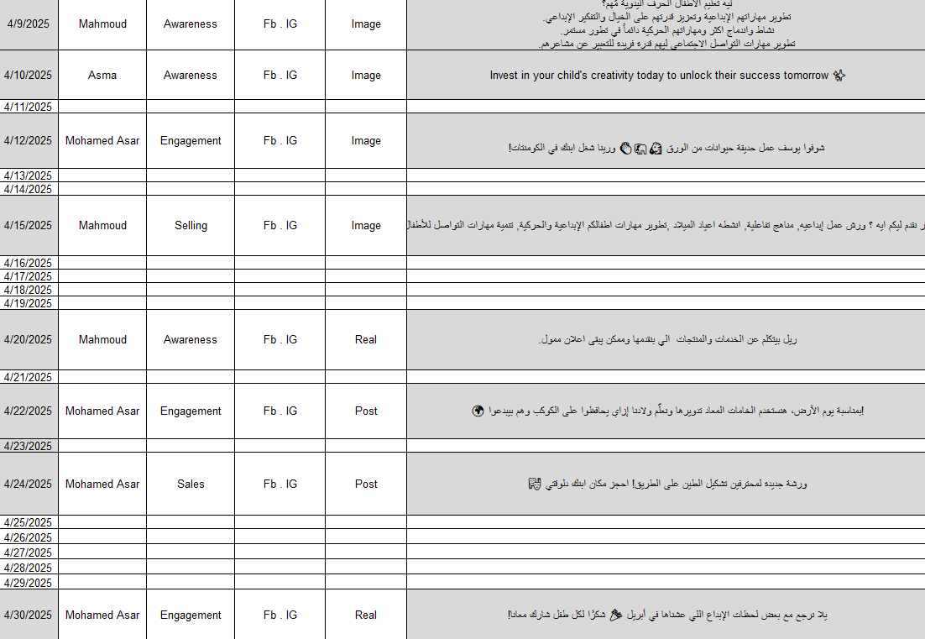

Slide 18
ACTION PLAN

Slide 19


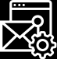
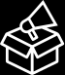
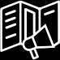

SOCIAL MEDIA MARKETING CHANNELS
Facebook
Instagram
Tiktok
Get Started
Get Started
Soon

Slide 20
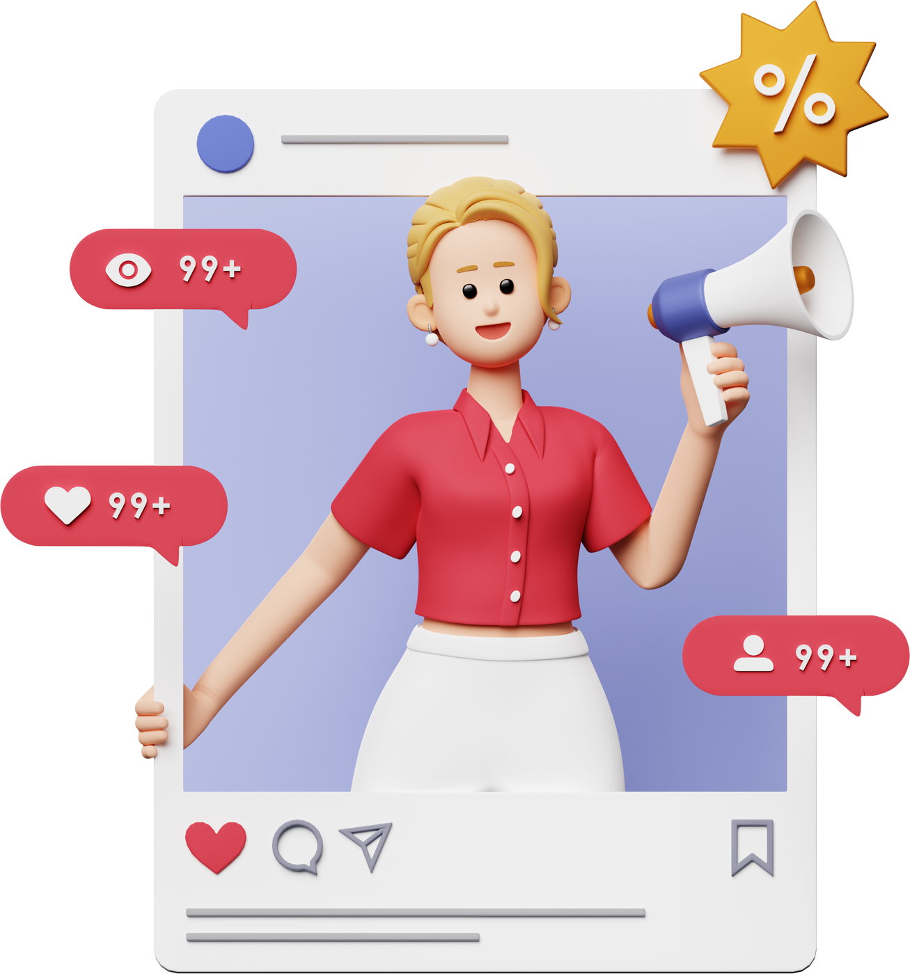



FACEBOOK
&
INSTAGRAM
We officially launched our social media presence with a clear goal: to creatively engage parents and inspire young minds through hands-on learning. From day one, we integrated artificial intelligence into our workflow — using AI tools to design visually appealing graphics and generate engaging, localized content that resonates with our Egyptian audience.
To increase visibility and attract our target audience, we ran paid ad campaigns on Facebook and Instagram, reaching thousands of parents who are passionate about their children’s creativity and development.
Our strategy combined smart tools with human creativity to build a fun, educational, and highly interactive online presence — and this is just the beginning!

Slide 21
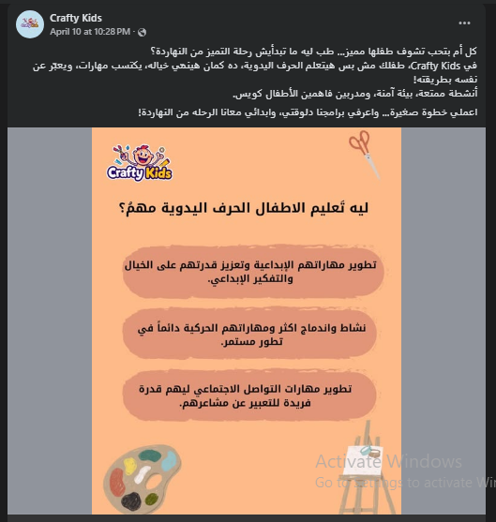
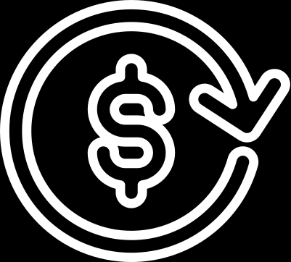
AWAIRENESS

Slide 22
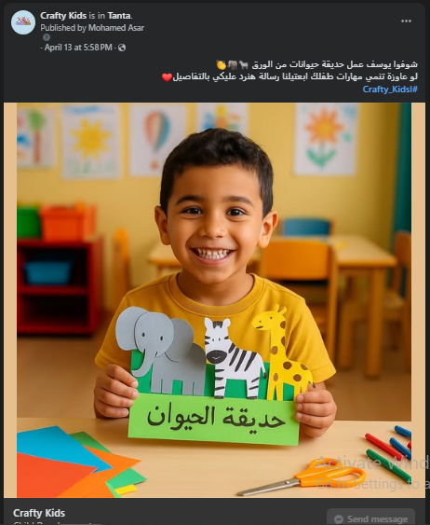
ENGAGEMENT

Slide 23
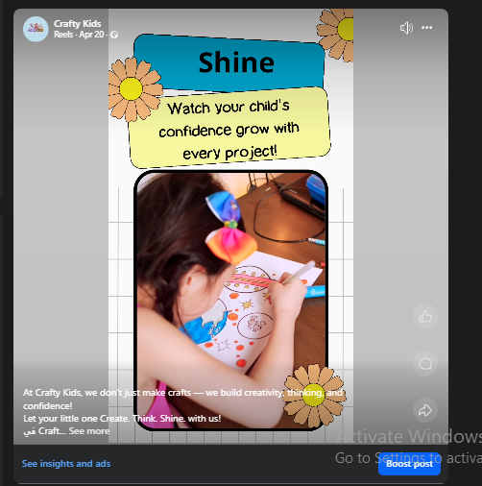
REALS

Slide 24
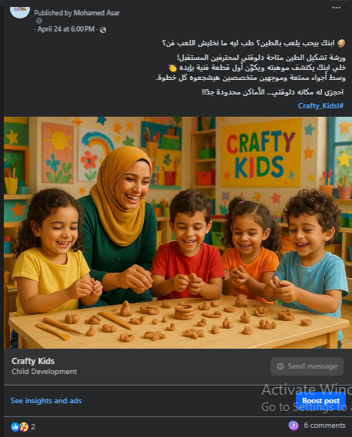
SALES

Slide 25
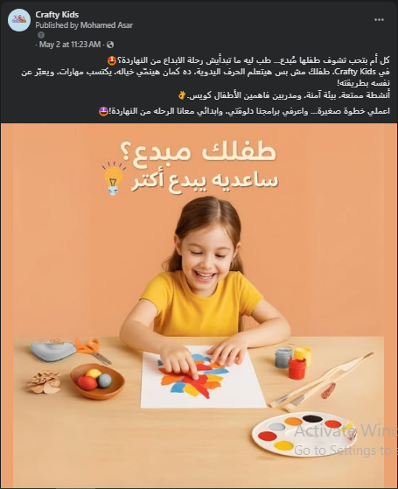
SALES

Slide 26
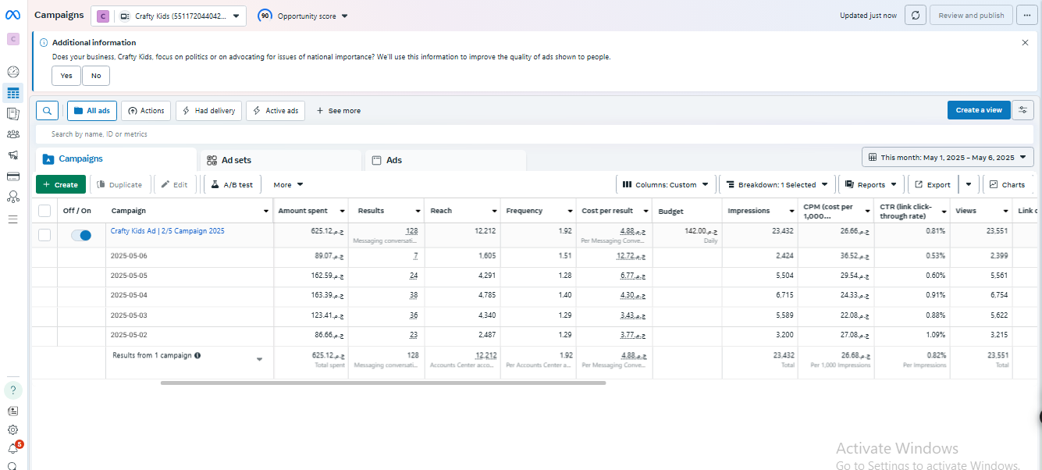
MESSEGES CAMPAIGN

Slide 27
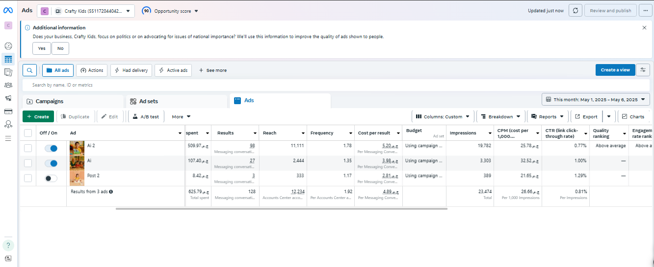
AD LEVEL

Slide 28

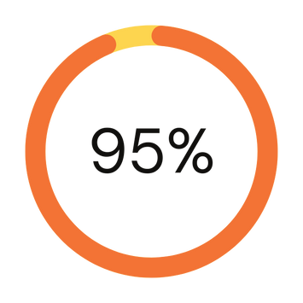
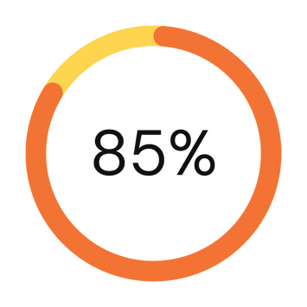
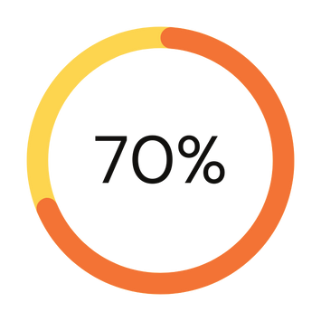
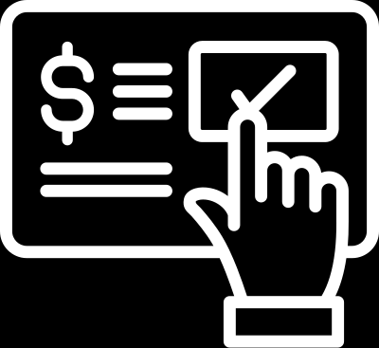
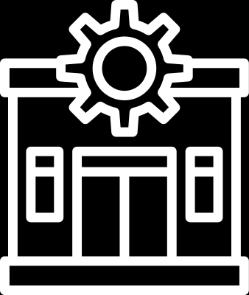
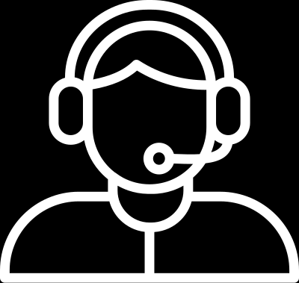
KEY PERFORMANCE INDICATORS
01
Imperesions & CPM
02
Messages & Cost Per Message
03
03
Click Through Rate (CTR)
02
01

Slide 29
RECCEOMNDATIONS AND IMPROVEMENTS
01
Expand to TikTok Ads:
Launch targeted ad campaigns on TikTok to reach a younger, highly engaged parent audience. Use short, fun, and creative content that aligns with the platform's tone.
01
02
03
04
02
Leverage Reels for Paid Campaigns:
Create high-quality, engaging Reels that showcase real workshop moments, kids’ artwork, or DIY tips. Boost top-performing Reels as paid ads to increase reach and engagement.
03
Community Interaction Strategy:
Actively reply to comments and DMs on posts and ads to build trust with parents. Use polls, questions, and reply stickers to encourage conversations and feedback.
04
Run Platform-Specific Content:
Customize content for each platform (e.g. playful & fast-paced for TikTok, informative & visual for Instagram, community-focused for Facebook) to maximize relevance and ROI

Slide 30
Do You Have Any questions?

Slide 31
Thank You
Presented by the Crafty Kids team in order:
Mahmoud Mokhles
Asmaa Gamal
Fatma Khairy
Mohamed Asar

